Slide 1
Lesson 14
Geometric Vectors
2.23.16
Warm-Up!
Evaluate the following:
(2) Draw an angle that is 210°.
(3) Draw an angle that is -210°.
(4) Using the words North, South, East, and West, how would you describe 210°? What about -210°?

Slide 2
Make up any Test or Quizzes by Friday or they will become permanent zeros.

Slide 3
Learning Objectives
By the end of this period you will be able to:
Find the magnitude and direction of a vector using a protractor, ruler, and components.
Solve real world problems using vectors.

Slide 4
Material Check:
Raise your protractors!

Slide 5
8.1 Geometric Vectors
Whenever we go somewhere we usually will need to know the direction and how far or how fast we will be going.
For example:
The car is going 95 miles per hour heading South on highway 85.
Walk a quarter of a mile north and then walk half a mile east.
We have some type of amount the magnitude (distance, velocity, acceleration, or forces) and direction. Together this makes a vector!

Slide 6
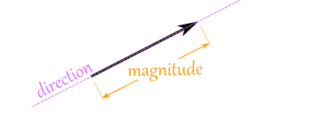
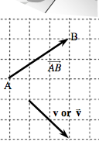
8.1 Geometric Vectors
Vector
A quantity that has both magnitude and direction.
Magnitude is the length or size of the vector.
Magnitude is denoted by absolute value bars since distance or size is always positive.
A vector is represented by a ray.
Can be named by one lowercase letter or two upper case letters that have a half arrowhead on top.

Slide 7
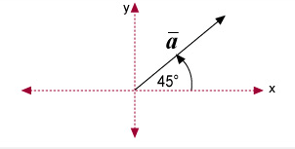
8.1 Geometric Vectors
Standard Position
The vector has its initial point at the origin.
The direction of the vector is the angle between the positive x-axis and the vector.

Slide 8
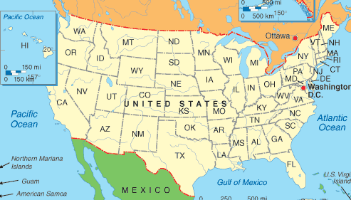
8.1 Geometric Vectors
If I am in Ottawa Canada, what vector would get me to California? Start by identifying the magnitude (distance) and then the direction.
Notes:
If I am in Ottawa Canada, what vector would I need to get me to California? Start by identifying the magnitude (distance) and then the direction.

Slide 9
8.1 Geometric Vectors
Resultant
The sum of two or more vectors (textbook definition).
The shortest distance from the beginning to end (my definition).
There are two methods to find the resultant (1) Triangle Method (Tip to Tail) or (2)Parallelogram.
Note – We will not discuss the Parallelogram method in this class, but if you want to learn it on your own go right ahead. ☺

Slide 10
8.1 Geometric Vectors
As a class we will demonstrate the Tip to Tail Method.
Vector 1: Magnitude – 3 students long
Direction - 90°
Vector 2: Magnitude – 4 students long
Direction - 0°
Resultant: Magnitude - ? students long
Direction - ?°
Lets add students diagonally until we can fit enough.
How do we find the degree?

Slide 11
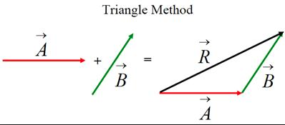
8.1 Geometric Vectors
Triangle Method (Tip to Tail)
Redraw vectors and connect the tip of one vector to the tail (initial position) of another vector.
Draw the resultant from the initial position to the end of the ray for the second ray.

Slide 12
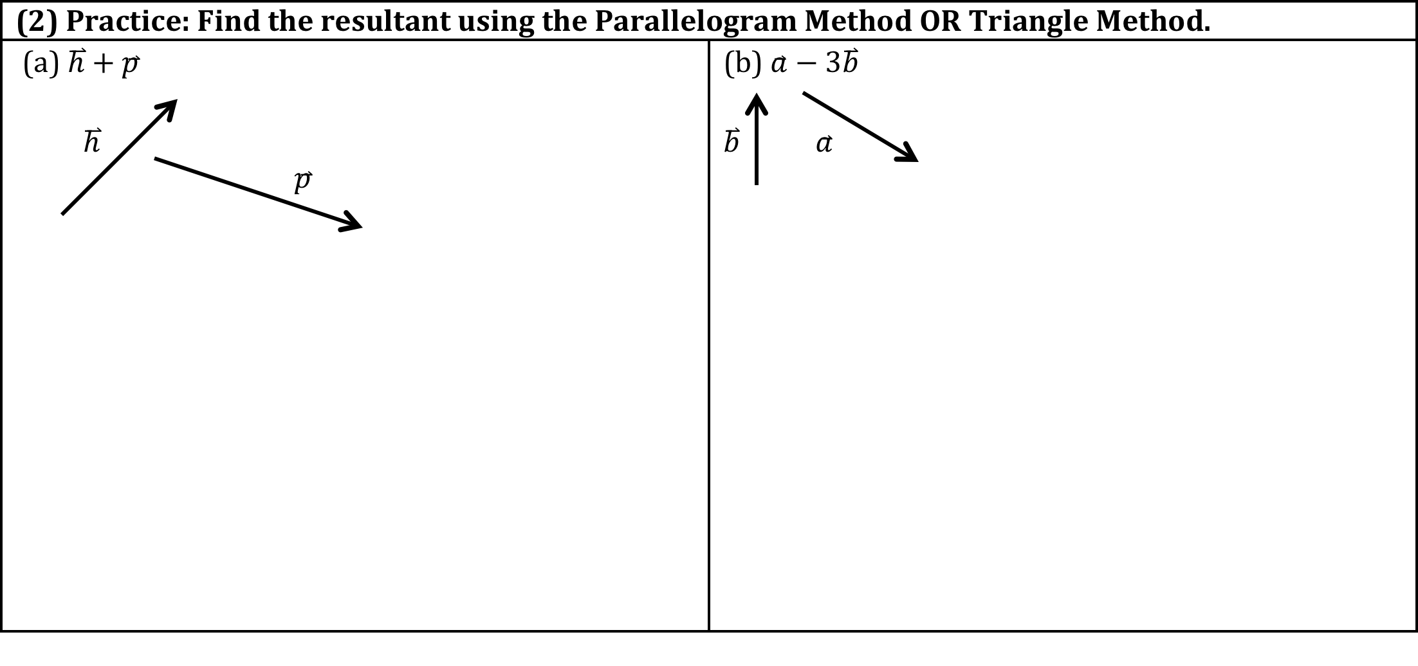
8.1 Geometric Vectors

Slide 13
8.1 Geometric Vectors
Obviously, it is not probable for us to run around Earth using a protractor and ruler to find vectors… There must be an easier way using math…
What if we have a plane flying at 210 mph east and wind going 150 mph south. What would be the resultant.

Slide 14
8.1 Geometric Vectors
What if I changed the scenario a tad bit…
What if we have a plane flying at 210 mph at 34° and wind going 150 mph at an angle of 112°. What would be the resultant.
We need some right triangles, hence we can create right triangles by breaking up the vectors into components! ☺

Slide 15
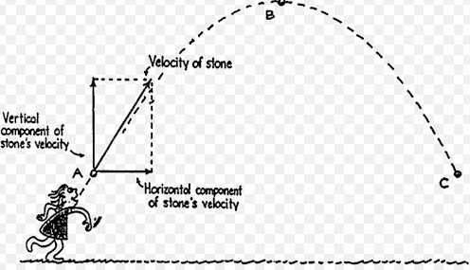
8.1 Geometric Vectors
Components
A vector is broken down into a vertical component (y axis vector) and an horizontal component (x axis vector).

Slide 16
8.1 Geometric Vectors
We will do (3) together and then we will see if you can complete (4).

Slide 17
Whiteboards!
A ship leaving ports sails for 75 miles in a direction 35° north of due east. Find the magnitude of the vertical and horizontal components.

Slide 18
8.1 Geometric Vectors
We will do (3) together and then we will see if you can complete (4).

Slide 19
Whiteboards!
Lenny Montana was a former 5-year world heavyweight wrestling champion and actor. Suppose that Lenny and a tag team wrestling partner are each pulling horizontally and at a right angle to each other on the arms of a wrestling opponent. Lenny exerts a force of 180 pounds due north while his partner exerts force of 125 pounds due east.
Draw a labeled diagram that represents the forces.
Determine the resultant force exerted on the opponent.
Determine the angle the resultant force makes with the east-west axis.

Slide 20
Use a ruler and program to determine the magnitude and direction of the vector. Find the horizontal and vertical components

Slide 21
HW:Pg. 491 #14-34 evens
Stamping up to 14- 24 for CW Credit.

Slide 22
Exit Ticket
You will have 4 minutes to complete the exit ticket;
Mr. Yen is not only a teacher of mathematics during the day, but a pirate between the hours of 2:31am to 3:31am.
This morning, while sailing the Pacific Ocean, his pirate ship was traveling 40° due north of east at 30 knots per hour while the wind was blowing 60° due south of east at 10 knots per hour. What was the resulting vector that Mr. Yen traveled after an hour?

